Slide 1
Book1
File created on: 3/21/25 7:32:38 PM PDT

Slide 2
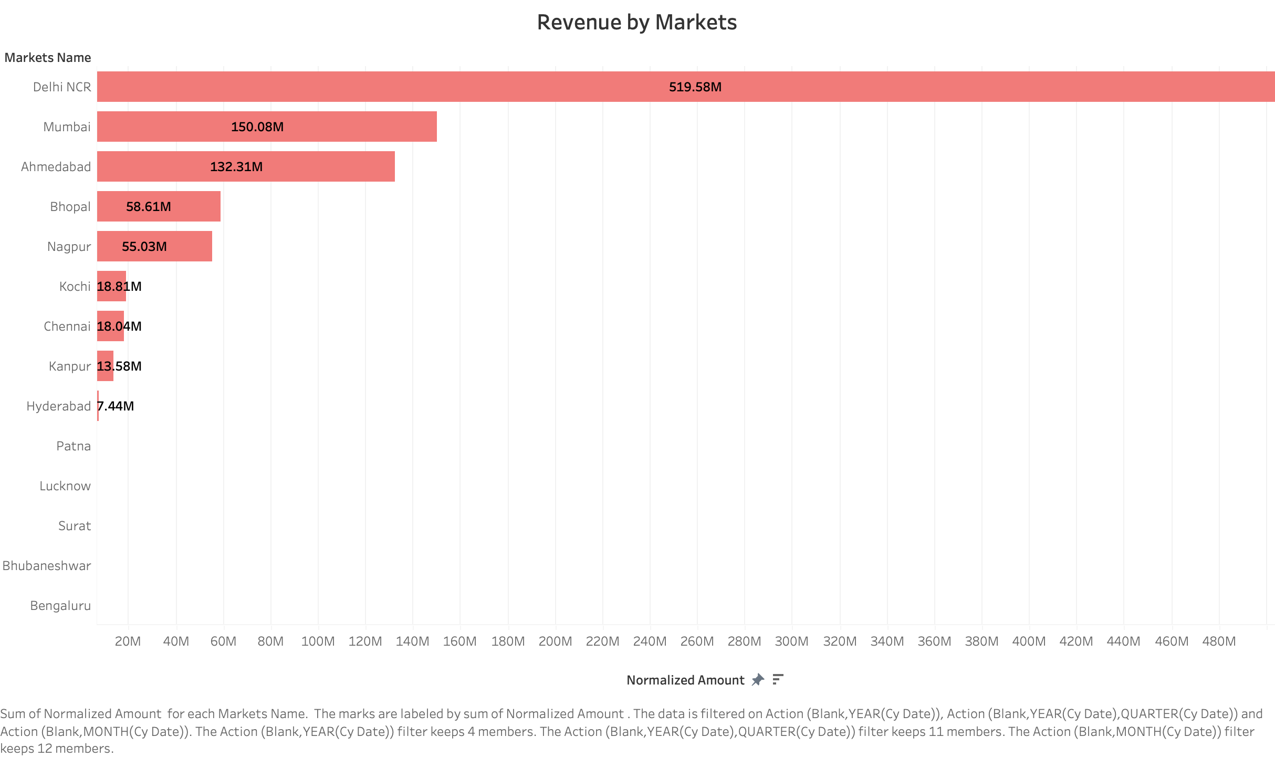

Slide 3
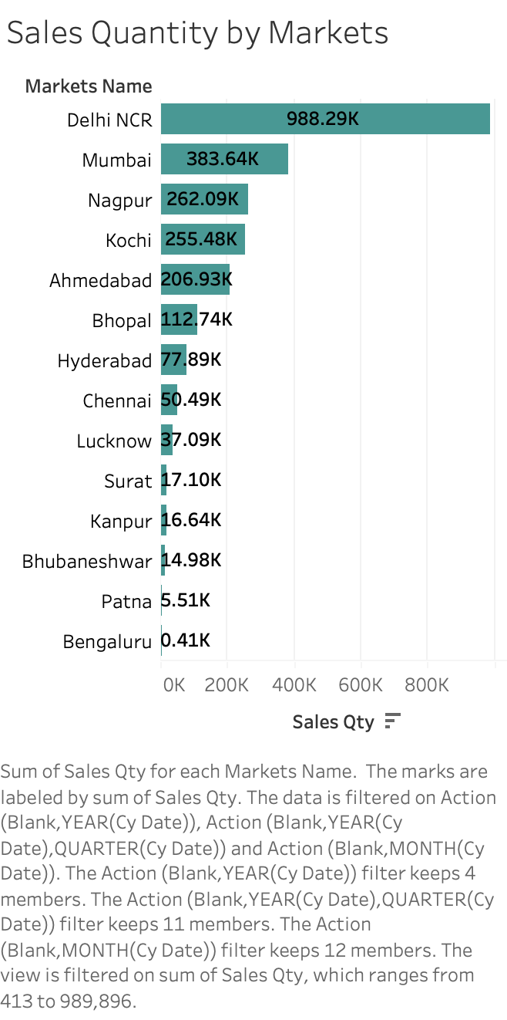

Slide 4
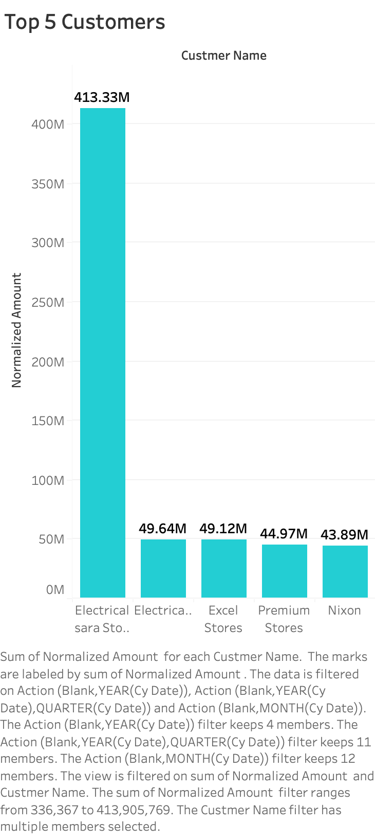

Slide 5
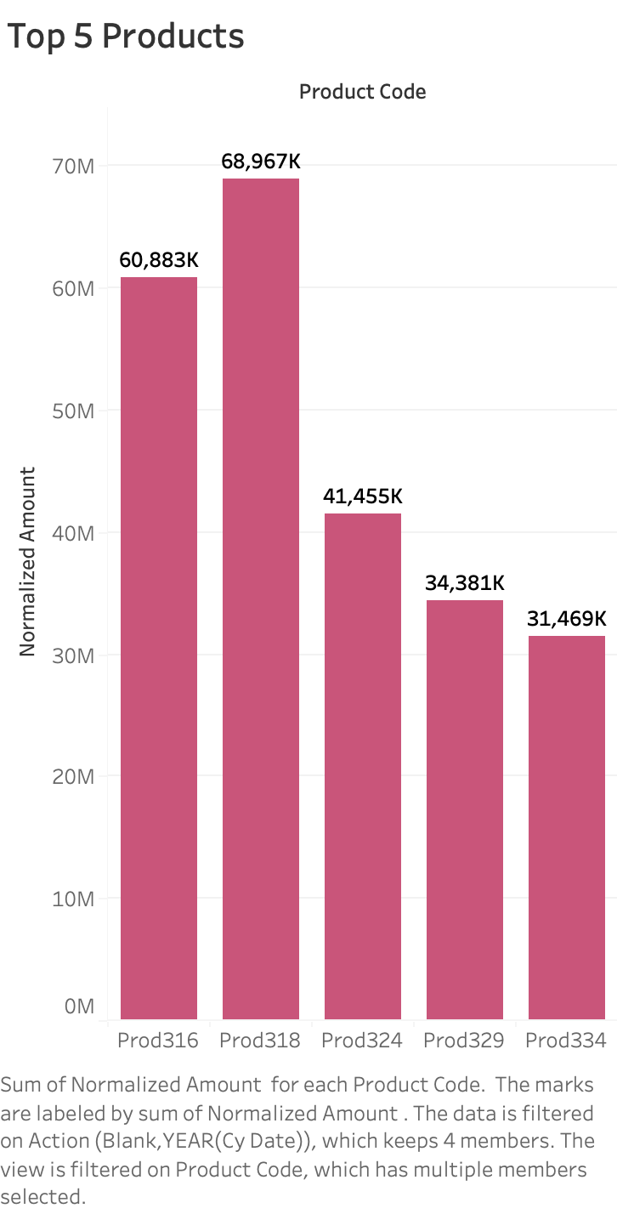

Slide 6
